Slide 1
As You Enter Today
Enter quietly and go directly to your seat. ☺
Pass out writing folders.
Warm Up: Discuss with your elbow partner. What is the structure for writing an introduction? What does the acronym mean?

Slide 2
Let’s Review What we’ve learned so far!
H
I
Hook Types
Introducing the Topic:
Historically, television served as a luxury item, but now it has become a necessity for many households.
Quote – Include a quote that’s related to the topic
Question- Ask an intriguing question (DO NOT REPEAT WRITING PROMPT)
Short Narrative (Anecdote) – Tell a story about the topic
T
How to Write a Thesis Statement
1. Read the Writing Task.
2. Underline the “some statement”.
3. Circle 2-3 words you plan to use when you rephrase the “some statement”.
4. Rephrase the “some statement”.

Slide 3
Monday March 2nd
Opening
Review Introductory Paragraph Structure
Work Session
Introduction Exemplar Analysis
Improving the “I” in HIT
Level Up Thesis Statement
Closing
Peer feedback on improved Introductory Paragraph
Extension (Time Permitting)
Body Paragraph Preview
Selecting Text Evidence
Paraphrasing Practice
Standard
ELAGSE7W2: Write informative/explanatory texts to examine a topic and convey ideas, concepts, and information through the selection, organization, and analysis of relevant content.
Learning Target
I can compose an effective introduction paragraph using the HIT method.
Essential Question
How do I write an effective introductory paragraph?

Slide 4
Introduction Exemplar Analysis: What can be improved?
Last weekend I binge watched the Avengers movies. I didn’t move off the sofa for 6 hours. Some people watch large amounts of television every day while others do not due to the potential damage television can cause.

Slide 5
Introduction Exemplar Analysis: What can be improved?
Watching an excessive amount of TV (4 or more hours each day) can lead to health issues. Some people watch large amounts of television every day while others do not due to the potential damage television can cause.

Slide 6
Introduction Exemplar Analysis: What are the strengths of this paragraph?
Have you ever watched television for so long that when you stood up your legs had fallen asleep? That happened to me last weekend when I was binge watching the Avengers movies. Historically, television started as a luxury item that only a few homes could afford, but today most every house has a television and watching television is a part of many people’s daily routine. Some people watch large amounts of television every day while others do not due to the potential damage television can cause.

Slide 7
How do you “Introduce The Topic?”
Provide some information about the topic discussed.
Sentence Starter for Introducing the Topic:
Historically, ______________ (tell the history of the topic).

Slide 8
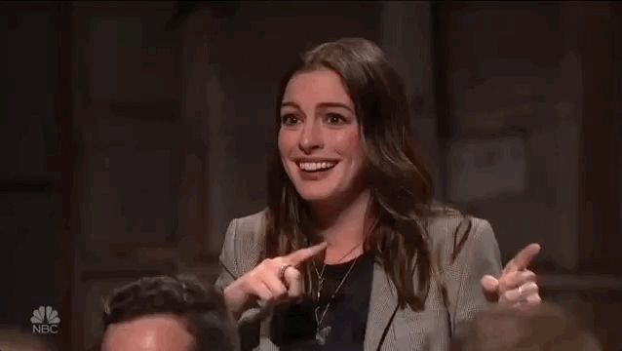
What do you if this happens?
Freeze up
Overcome

Slide 9
But Wait, Our Thesis statement isn’t done
1. Read the Writing Task.
2. Underline the “some statement”.
3. Circle 2-3 words you plan to use when you rephrase the “some statement”.
4. Rephrase the “some statement”.
5. Add new sentence: answering the question from prompt.
Animals may form unusual bonds with other species. This is how a mother dog could care for abandoned kittens.
People may feel as though groupwork provides new opportunities, however the process may be problematic. Leaders should consider _____________ to encourage successful group problem solving.
People may think that clearcutting land is the best approach to creating new development, others prefer to refurbish existing buildings. Developers should consider the impact on the environment when they clear-cut land.

Slide 10
But Wait, Our Thesis statement isn’t done
1. Read the Writing Task.
2. Underline the “some statement”.
3. Circle 2-3 words you plan to use when you rephrase the “some statement”.
4. Rephrase the “some statement”.
5. Restate and answer the question (usually found after “explaining”) in writing prompt
Final Thesis Example:
Some people desire to feed wild birds, while others refrain due to the potential harm. The factors people should consider before feeding wild birds are the bird’s change in migration patterns and shift towards dependence.

Slide 11
Let’s See another example ☺
Strong thesis ☺
Writing Task
Some people have made television a part of their everyday lives, while others refrain from watching television due to its potential harm.
Write an informational/explanatory essay in your own words explaining why this can happen. What can adults and children do to avoid harm caused by watching television?
Be sure to use information from BOTH passages in your informational/explanatory essay.
While some people watch television daily, others try to avoid watching television because of its possible harm. Adults and children can …

Slide 12
Revise your Introductory paragraph and expand your thesis statement
Directions:
Review your introductory paragraphs feedback
Make necessary revisions and improvements
*This is an independent activity*

Slide 13
Closing: Introductory Paragraph Peer Evaluation: 5 Minutes
Directions:
1. Trade papers with an elbow partner.
2. Read your partner’s thesis.
3. Discuss any necessary corrections.

Slide 14
Body Paragraphs: MEAEALS
Same concept as MEALS paragraph from argumentative writing
Must have 2 pieces of text evidence with analysis
1 quote
1 paraphrase
Acronym is now MEAEALS

Slide 15
Main Body Paragraphs
1. Read each article.
2. Highlight two pieces of evidence in each article.
3. Write one piece of evidence from each article in your own words (Paraphrase).
4. On the back of your half sheet of loose-leaf paper write the original quote and the paraphrased quote.
Original quote: “Compared to those who watched less than two hours of TV per day, people who watched four hours or more were 80 percent more likely to die from heart disease and 46 percent more likely to die from any cause.”
My Words (paraphrase): Article “TV Watching and Health” reveals that individuals are more prone to illnesses or death if they watch an excessive amount (four hours or more) of television daily.

Slide 16
Main Body Paragraph Continued- Peer Evaluation: 5 Minutes
Directions:
1. Trade papers with an elbow partner.
2. Read your partner’s paraphrased evidence.
3. Discuss any necessary corrections.

