Slide 1
Sequence of Events & Transitions
Mini Lesson 1: Narrative Writing

Slide 2
What is a "Sequence?"
A story is made of many parts working together. Some of these parts are characters, setting, and conflict. We know these already. What we may not consider is "sequence.“
"Sequence" means "the order."
Namely, it means "the order of events.“
"Events" are the things that happen that are important to the story you are telling.

Slide 3
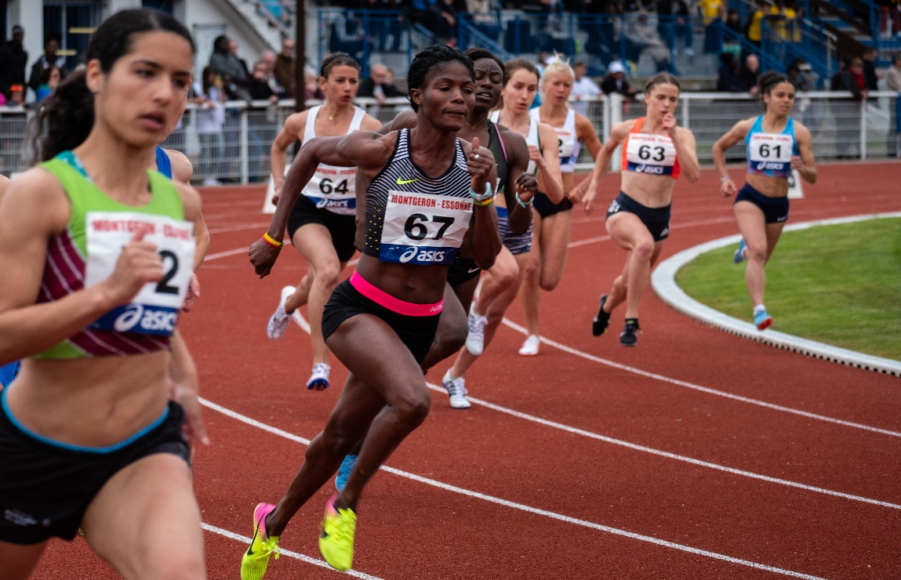
Your order of events are important!
In writing, we form narratives into a beginning, middle, and end.
When telling your stories, you must think about what should happen and form an appropriate order.
It wouldn't make sense for a runner to win a race before she went up to the starting line, correct?

Slide 4
When things are in a sequence, they make sense.

Slide 5
Using sequencing words can show the order that things go in. Some examples are:
First
Next
Soon
Last
Finally
Then
After
Afterwards
Second
Meanwhile
Before
Third
Again
Immediately
Eventually
In addition to
In conclusion

Slide 6
These sequencing words are also known as “transitions.”
Take a look at your transitions list.

Slide 7
Great stories don’t leave their readers wondering what’s going on.
Drive your readers through your experience.
Only you know your story.

